Slide 1
Meet your english assistant
Famous people

Slide 2
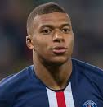
20 years old
Kylian Mbappé

Slide 3
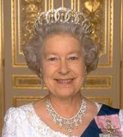
93 years old
Elisabeth II

Slide 4
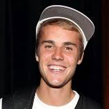
25 years old
Justin Bieber

Slide 5
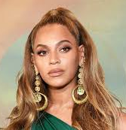
38 years old
Beyonce

Slide 6
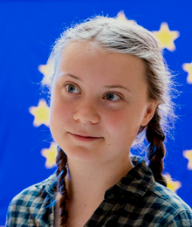
16 years old
Greta Thunberg

Slide 7
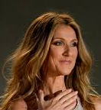
51 years old
Céline Dion

Slide 8
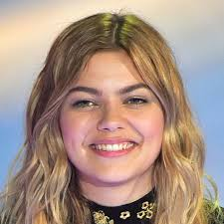
Louane
22 years old

Slide 9
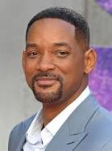
51 years old
Will Smith

Slide 10
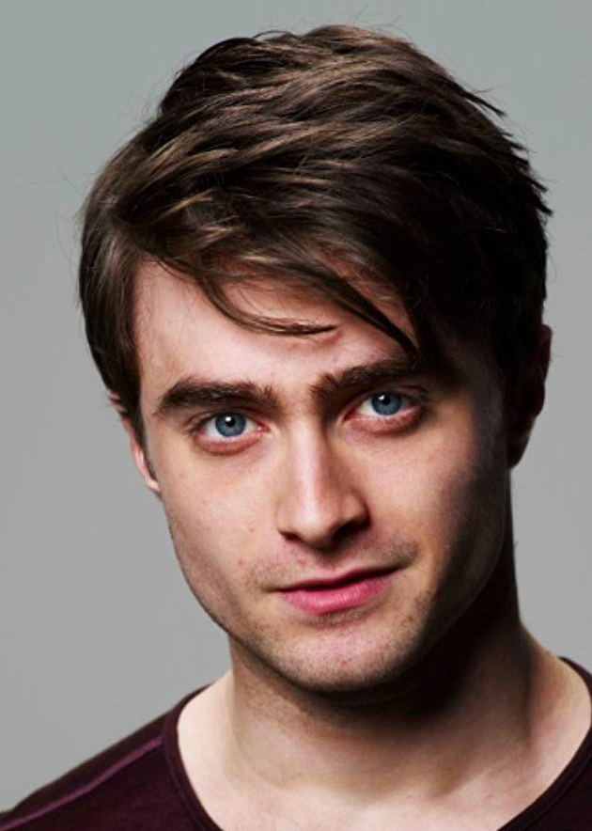
30 years old
Daniel Radcliffe

Slide 11
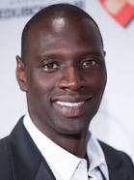
41 years old
Omar Sy

Slide 12
