Slide 1
MISSION 1 – MEET Videoconference N°1

Slide 2
GAME N° 1
WHAT DO YOU REMEMBER ABOUT ME?
WRONG!
RIGHT!

Slide 3
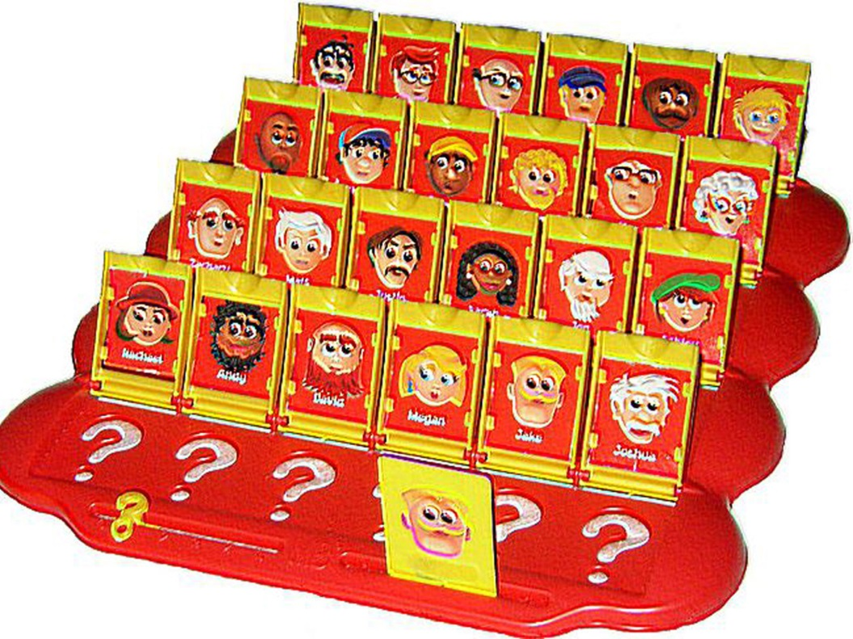
GAME N° 2
WHO IS THIS?

Slide 4
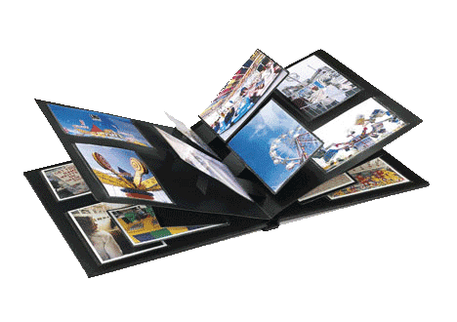
GAME N° 3
LET’S MAKE YOUR PHOTO ALBUM!

Slide 5
YOUR NEW MISSION…

