Slide 1
CM-V7 Let’s have a fashion show!

Slide 2
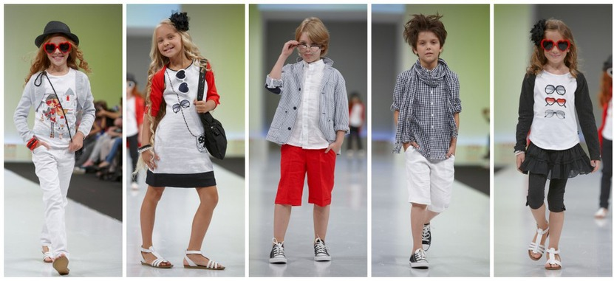
LET’S HAVE A FASHION SHOW!

Slide 3
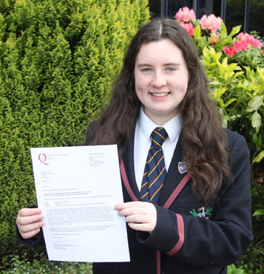
My school uniform
My friend’s school uniform

Slide 4
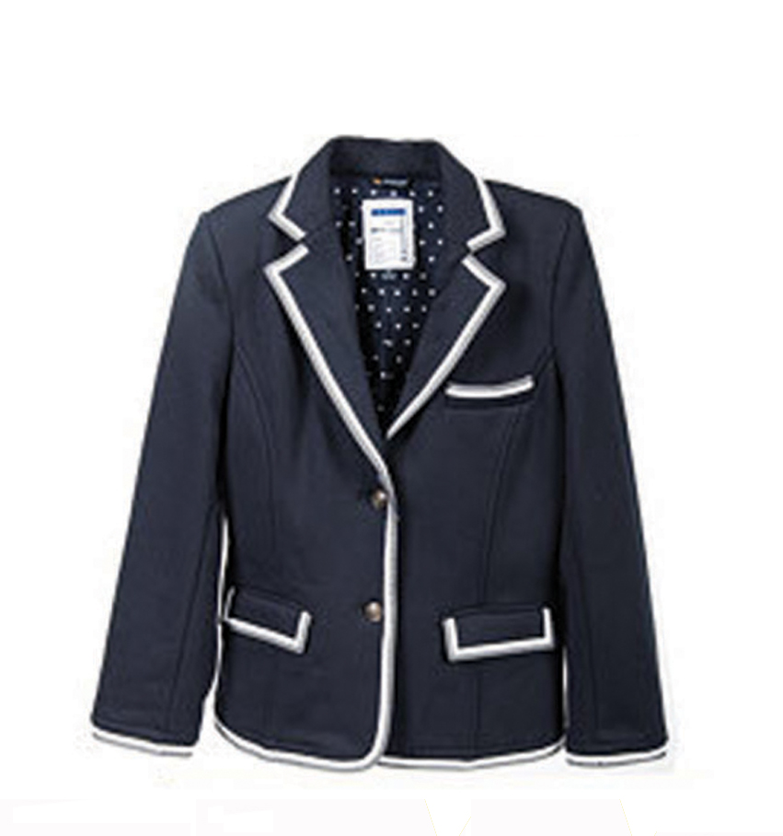
a jacket

Slide 5
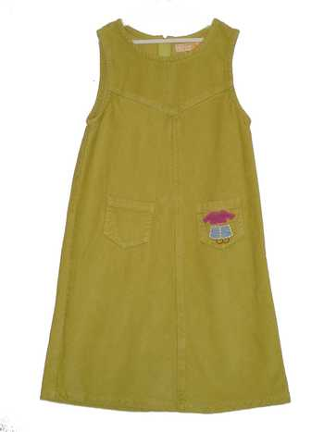
a dress

Slide 6
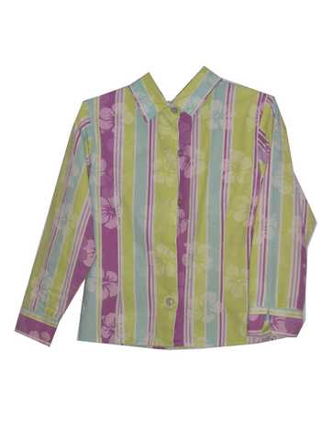
a shirt

Slide 7
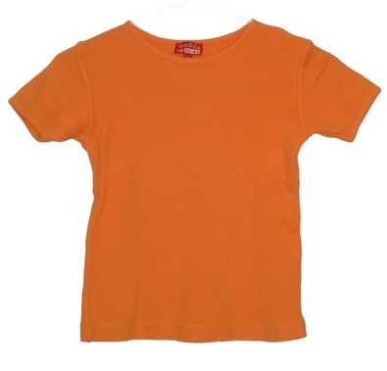
a T-shirt

Slide 8
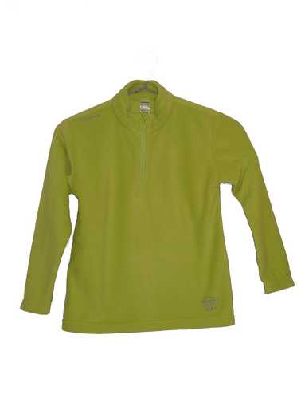
a sweater

Slide 9
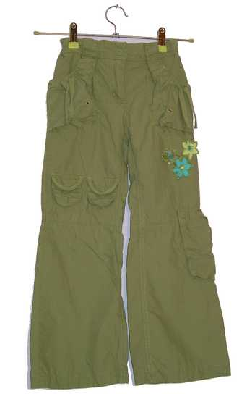
trousers (UK)
pants (US)

Slide 10
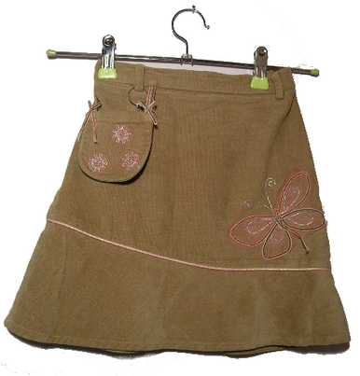
a skirt

Slide 11
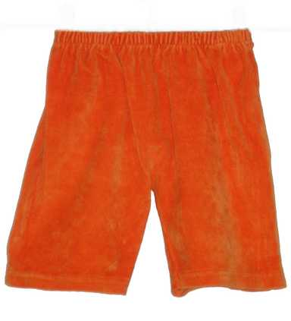
shorts

Slide 12
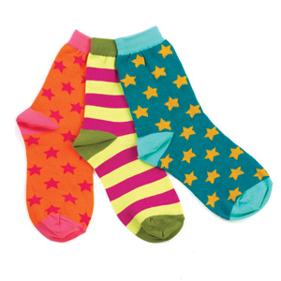
socks

Slide 13
shoes

Slide 14
a T-shirt
a shirt
a jacket
a dress
trousers
pants
a sweater
a skirt
shorts
socks
shoes

Slide 15
A
B
C
D
E
1. a sweater
6. a skirt
F
2. a shirt
7. shorts
3. trousers / pants
8. socks
4. a dress
9. shoes
5. a jacket
10. a T-shirt
G
H
I
J

Slide 17
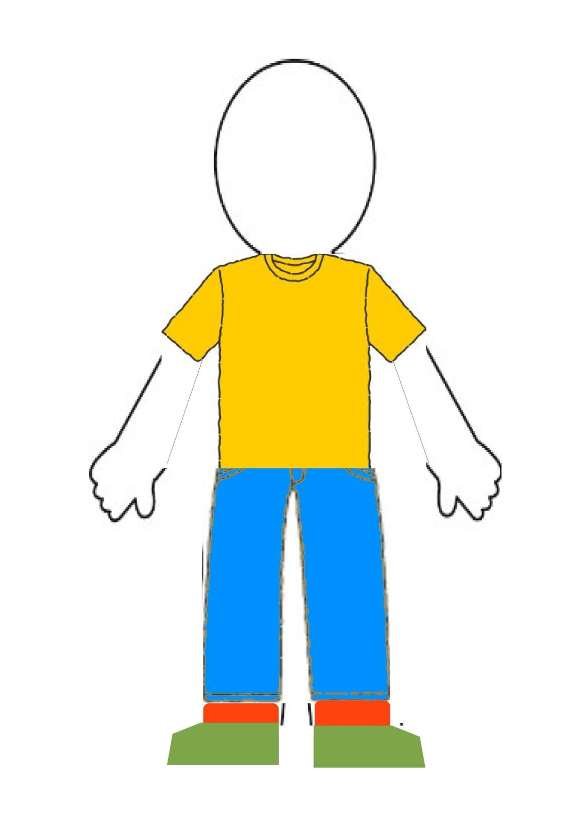
Listen and draw

