Slide 1
Visioconference n°6
CM1&2

Slide 2
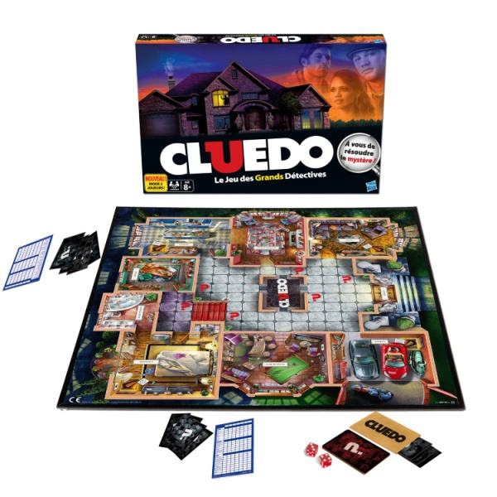

Slide 3
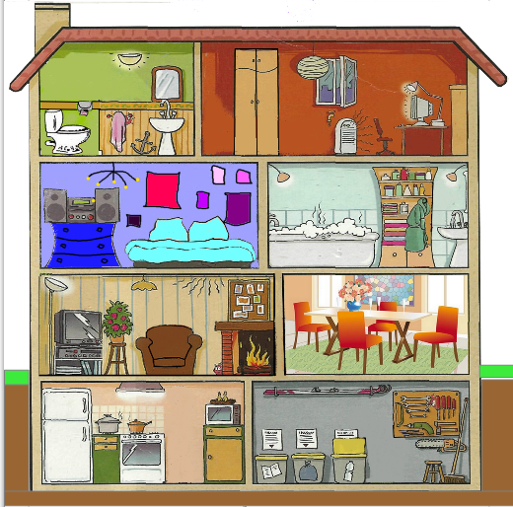

Slide 4
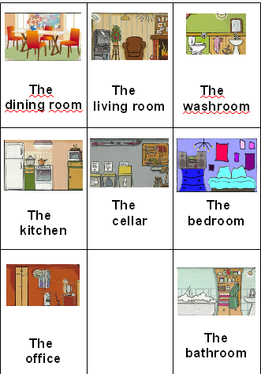
The toilets
The garage

Slide 5
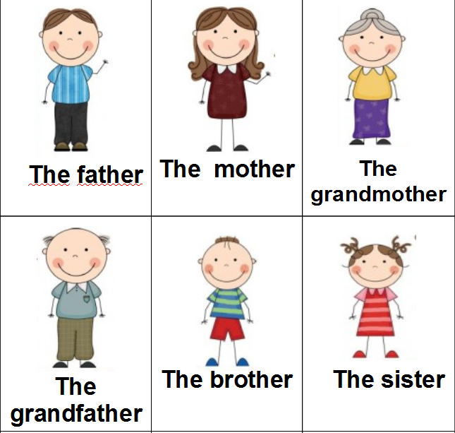
The uncle
The aunt
The cousin
The cousin

Slide 6
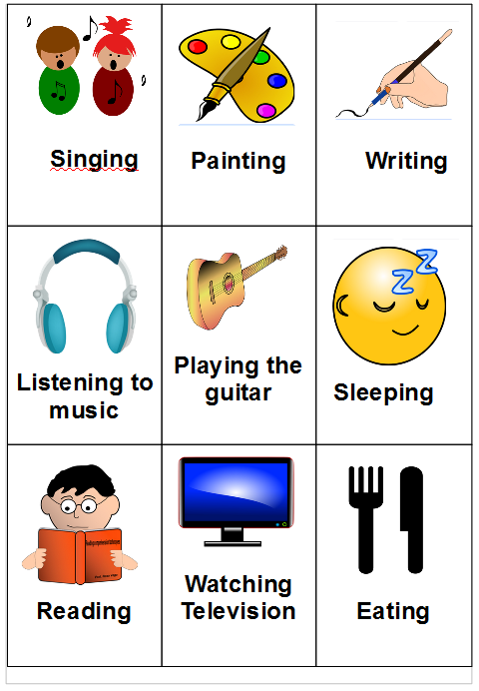

Slide 7
How many words can you say in 30 seconds?

Slide 8
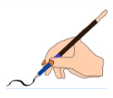

Slide 10
singing
listening to music
sleeping
playing the guitar
eating
reading
writing
watching TV
painting

Slide 11
singing
listening to music
sleeping
playing the guitar
eating
reading
writing
watching TV
painting

Slide 13
The grandfather
is writing
in the living room

Slide 14
The …
is …
in the …
The uncle is playing the guitar in the bedroom

Slide 15
The …
is …
in the …
The cousin is watching TV in the office

Slide 16
The …
is …
in the …
The grandmother is sleeping in the bedroom

Slide 17
The father is painting in the garage

Slide 18
The mother is reading in the living room

Slide 19
The brother is eating in the kitchen

Slide 20
The sister is listening to music in the bathroom

Slide 21
The aunt is eating in the dining room

Slide 22
The grandfather is writing in the living room

Slide 23
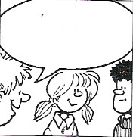
?
I think the father is writing in the living room.
I know the father is writing in the living room.

Slide 24
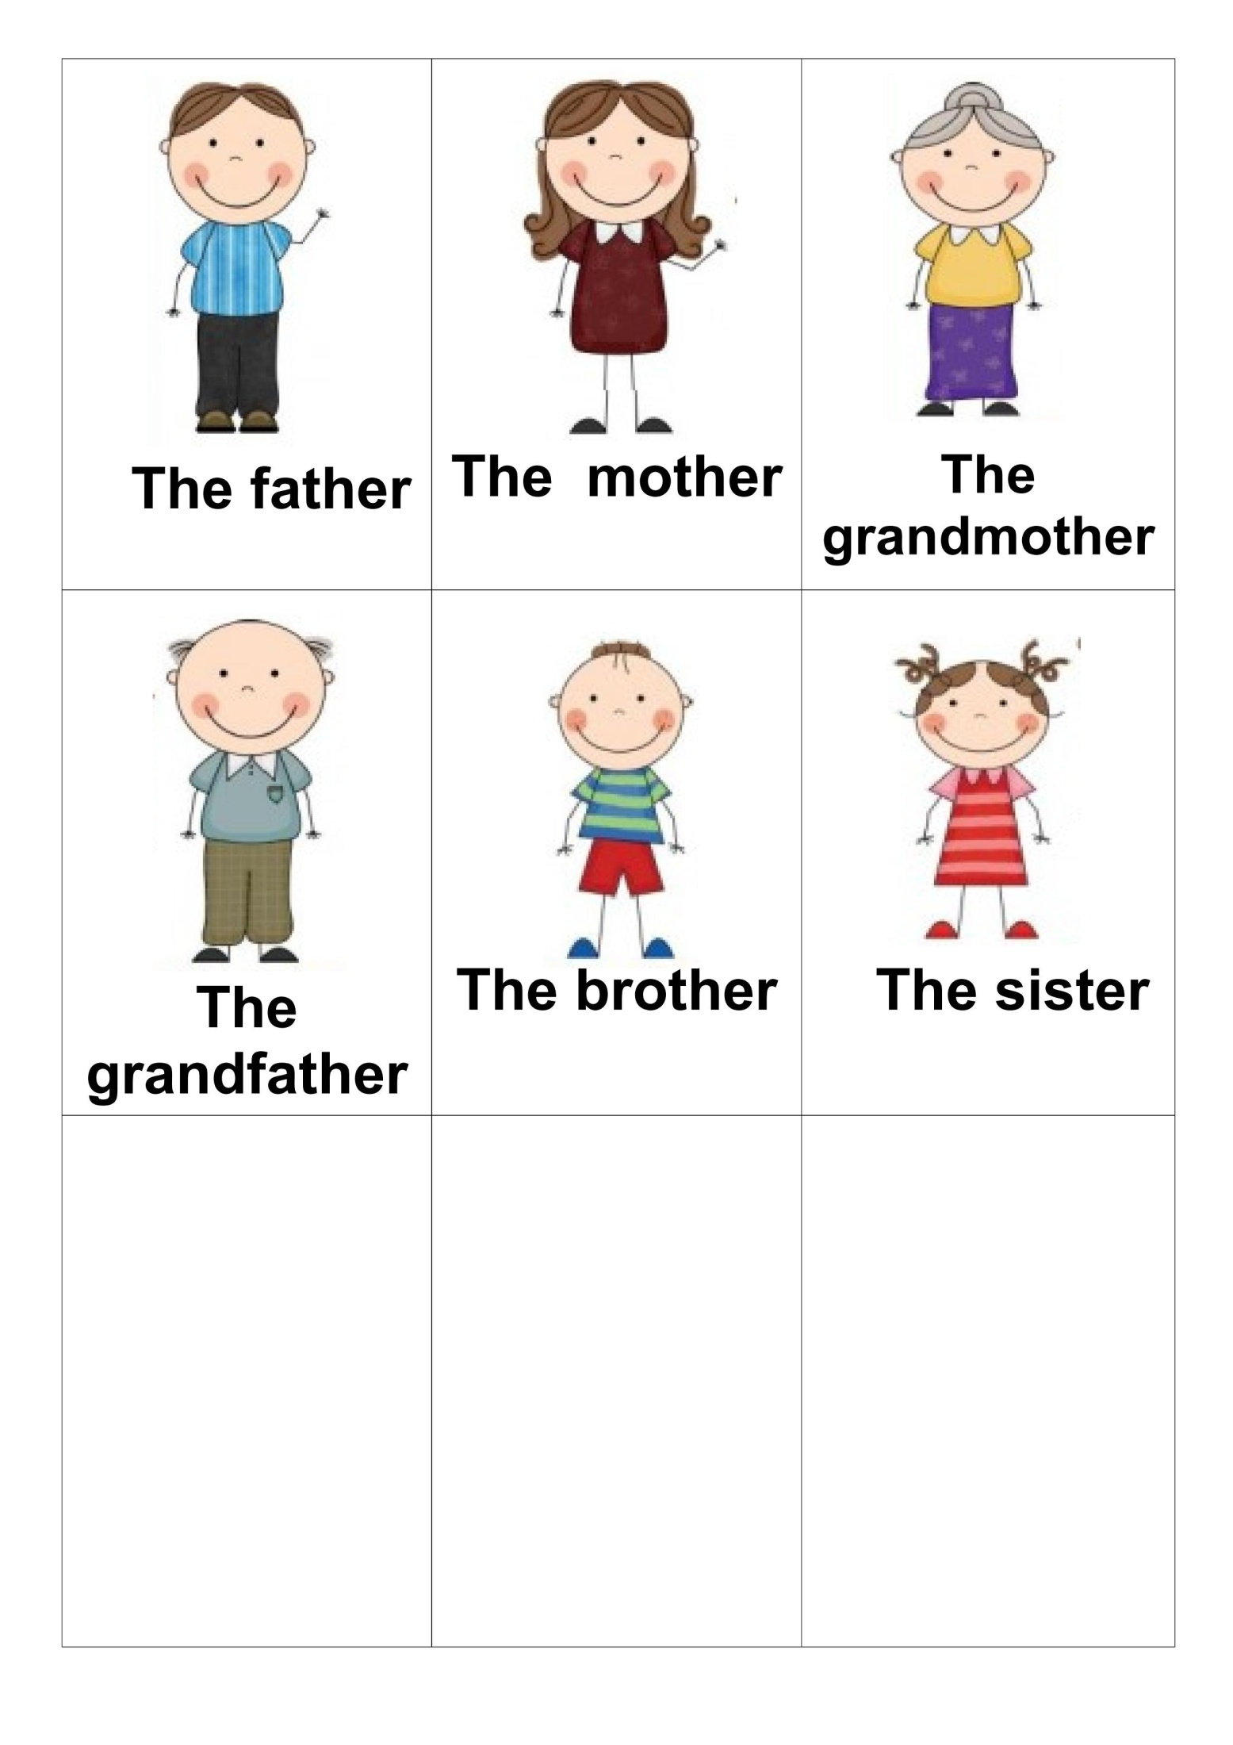
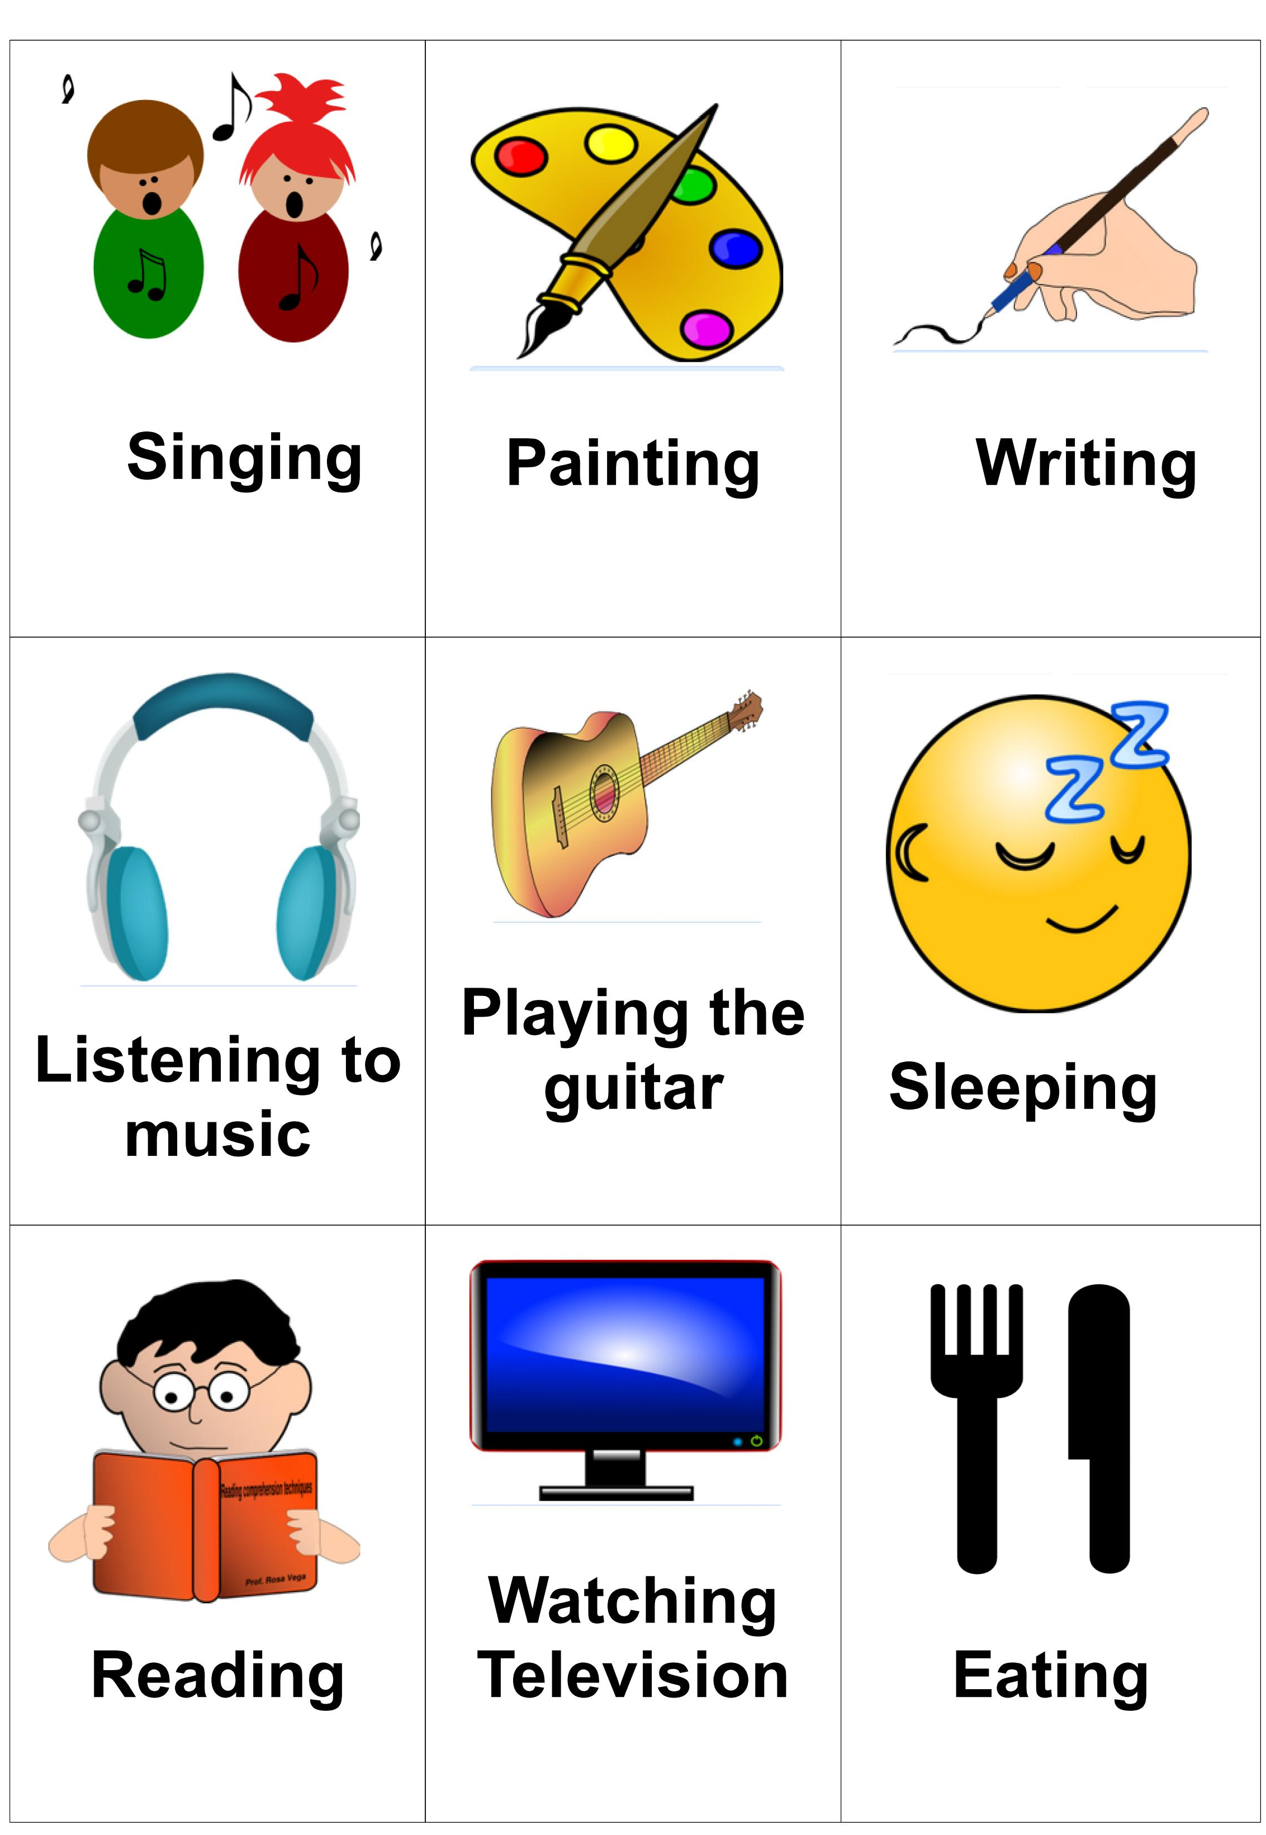
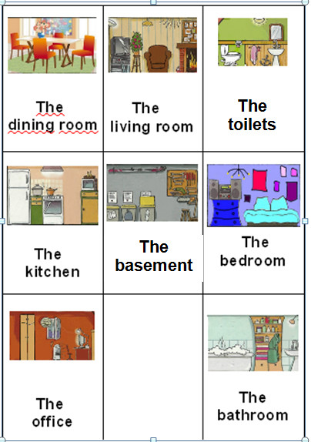
Your Clue game sheet

Slide 25
?
‘I think the mother is eating in the kitchen’
‘It’s not the mother, it’s not eating. But it is in the kitchen!’

Slide 26
?
‘I think the … is … in the kitchen’
‘It’s …

Slide 27
I know!
The grandfather is playing the guitar in the kitchen!

Slide 28
?
‘I think the … is … in …’
‘It’s …

